Slide 1

Application Components
Activities–visual user interface focused on a single thing a user can do
•Services–no visual interface –they run in the background
•Broadcast Receivers–receive and react to broadcast announcements
•Content Providers–allow data exchange between applications

Slide 2
Activities
Basic component of most applications
Most applications have several activities that start each other as needed
Each is implemented as a subclass of the base Activity class
An activity presents a visual user interface for one focused the user.
The visual content of the window is provided by a hierarchy of views.
objects derived from the base View class.

Slide 3
Continue…
For example, an email application might have one activity that
shows a list of new emails, another activity to compose an
email, and another activity for reading emails.
Although the activities work together to form a cohesive user
experience in the email application, each one is independent of
the others

Slide 4
Activities –The View
Each activity has a default window to draw in (although it may prompt for dialogs or notifications)
The content of the window is a view or a group of views (derived from View or ViewGroup)
Example of views: buttons, text fields, scroll bars, menu items, check boxes, etc.
View(Group) made visible via Activity.setContentView() method.

Slide 5
Activities and Tasks
As, we know An activity presents a visual user interface
Task is what the user experiences as an application.
Task is a group of related activities, arranged in a stack.
The activity at the top of the stack is one that's currently running.
All the activities in a task move together as a unit.

Slide 6
Activity Lifecycle
An activity has essentially three states
–Active or Running
–Paused
–Stopped
Activity Lifetime
–Entire Lifetime [onCreate()to onDestroy()]
–Visible Lifetime [onStart()to onStop()]
–Foreground Lifetime [onResume()to onPause()]
An implementation of any activity lifecycle method should always first call the superclassversion

Slide 7
Activity Lifecycle in detail
Resumed
  The activity is in the foreground of the screen and has user focus
  Paused
  Another activity is in the foreground and has focus, but this one is still visible
Stopped
    The activity is completely replaced by another activity (the activity is now in the "background"). A stopped activity is also still alive
    It can be killed by the system when memory is needed

Slide 8
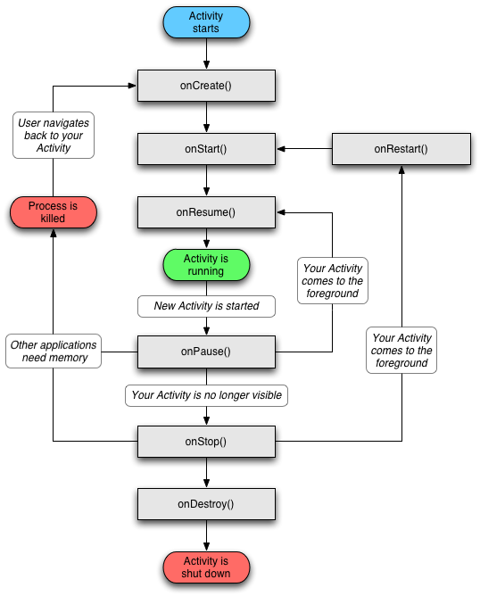

Slide 9
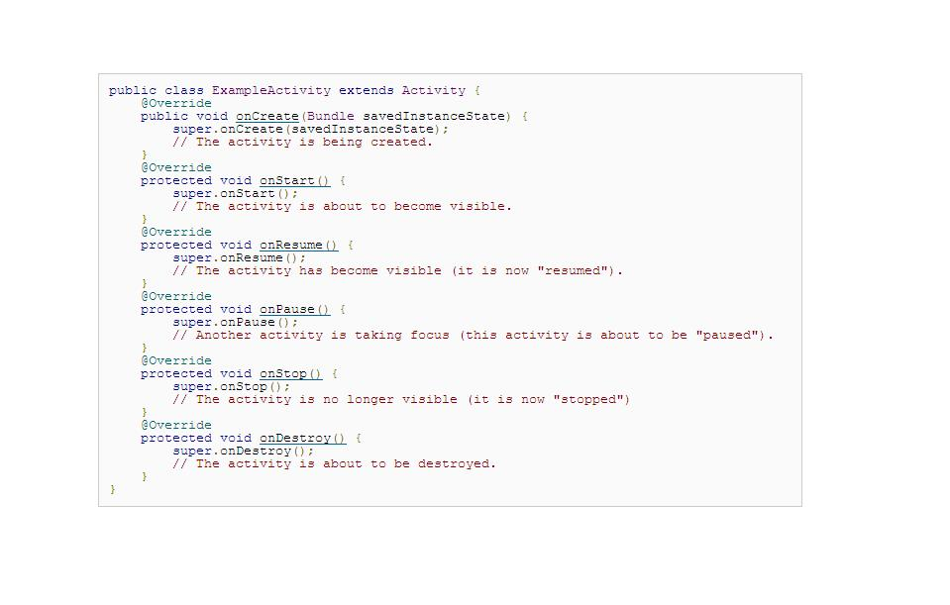

Slide 10
Services
A Service does not have a visual interface and runs in the background. OR A Service is code that is long-lived and runs without a UI.
Each service extends the Servicebase class.
It's possible to connect to an ongoing service and communicate it through the interface exposed by that service.
Services run in the main thread of the application process.

Slide 11
For example,
In a media player application, there would probably be one or more activities that allow the user to choose songs and start playing them. However, the music playback itself should not be handled by an activity because the user will expect the music to keep playing even after navigating to a new screen. the media player activity could start a service using Context.startService() to run in the background to keep the music going.
Another eg is , it might fetch data over the network without blocking user interaction with an activity

Slide 12
Service Lifecycle
A service can be used in two ways
– startService()
– stopService()
– bindService()
– unbindService()
Service Lifetime
– Entire Lifetime [onCreate()to onDestroy()]
– Active Lifetime [onStart()]
The onCreate() and onDestroy() methods are called for all services.
onStart()is called only for services started by startService().

Slide 13
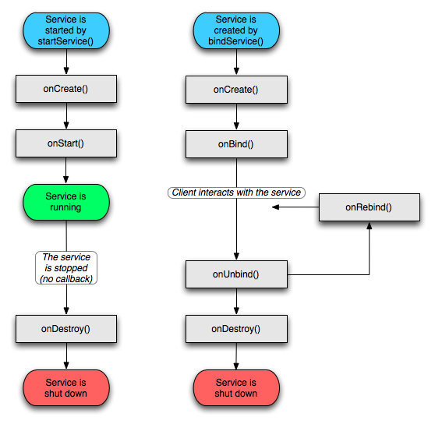

Slide 14
Services
Runs in the background indefinitely
Examples
  –Network Downloads
–Playing Music
You can bind to a an existing service and control its operation

Slide 15
Broadcast Receivers
A broadcast receiver is a component that responds to system-wide broadcast announcements. Many broadcasts originate from the system
Receive and react to broadcast announcements
Extend the class BroadcastReceiver
Examples of broadcasts:
- Low battery
- power connected
- shutdown
- timezonechanged, etc.
- Other applications can initiate broadcasts
Many broadcasts originate in system code.
Broadcast receivers do not display a user interface but they can start an activity or alert user.

Slide 16
Broadcast receiver Lifecycle
A broadcast receiver has single callback method
–onReceive()
The lifetime of a broadcast receiver is only during the execution of onReceive()method.
A process with an active broadcast receiver is protected from being killed.

Slide 17
Content Providers
“ A content provider manages a shared set of application data.”
You can store the data in the file system, an SQLite database, on the web, or any other persistent storage location your application can access.
A content provider is useful if you want your application's data to be shared with other applications.
A content provider is a class that implements a standard set of methods to let other applications store and retrieve the type of data that is handled by that content provider.
For example, the Android system provides a content provider that manages the user's contact information.

Slide 18
Content Providers
Makes some of the application data available to other applications
It’s the only way to transfer data between applications in Android (no shared files, shared memory, pipes, etc.)
Other applications use a ContentResolverobject to access the data provided via a ContentProvider

Slide 19
Content Providers
All content providers extends the ContentProviderbase class.
Content Providers are accessed through ContentResolverobject.
Content Providers and Content Resolvers enable inter-process communication (IPC)

Slide 20
Intents
Three of the four component types—activities, services, and broadcast receivers—are activated by an asynchronous message called an intent.
Intents bind individual components to each other at runtime
An intent is an Intentobject with a message content.
  An intent is an object of Intent class that holds the content of the message.
Activities, services and broadcast receivers are started by intents.

Slide 21
ContentProvidersare started by ContentResolvers:
– An activity started by Context.startActivity(Intent intent) or
Activity.startActivityForResult(Intent intent,intRequestCode)
– A service started by Context.startService(Intent service)
– An application can initiate a broadcastby using an Intent in any of
Context. sendBroadcast(Intent intent)
Context.sendOrderedBroadcast()
Context.sendStickyBroadcast()

Slide 22
Intents
Intents are Asynchronous messages used to convey a request or message.
Intent can contain
– Component name
– Action
– Data
– Category
– Flags

Slide 23
Shutting down components
Activities
– Can terminate itself via finish();
– Can terminate other activities it started via finishActivity();
Services
– Can terminate via stopSelf(); or Context.stopService();
Content Providers
–Are only active when responding to ContentResolvers
Broadcast Receivers
–Are only active when responding to broadcasts

Slide 24
The Manifest File
Before the Android system can start an application component, the system must know that the component exists by reading the application's AndroidManifest.xml file
Your application must declare all its components in this file, which must be at the root of the application project directory.

Slide 25
Continue…
The manifest does a number of things in addition to declaring the application's components, such as
Identify any user permissions the application requires, such as Internet access or read-access to the user's contacts.
Declare the minimum API Level required by the application, based on which APIs the application uses.
3. Declare hardware and software features used or required by the application, such as a camera, bluetooth services, or a multitouch screen.
4. API libraries the application needs to be linked against

Slide 26
Example (manifest)
<?xml version="1.0" encoding="utf-8"?>
<manifest ... >
<application android:icon="@drawable/app_icon.png" ...>
<activity
android:name="com.example.project.ExampleActivity"
android:label="@string/example_label“….
</activity>
...
</application>
</manifest>

Slide 27
Explanation
<application> element
android:icon attribute points to resources for an icon that identifies the application
<activity> element
android:name attribute specifies the fully qualified class name of the Activity subclass and the android:label attributes specifies a string to use as the user-visible label for the activity.

Slide 28
Declare All Application Components
<activity> elements for activities
<service> elements for services
<receiver> elements for broadcast receivers
<provider> elements for content providers
Note :
Activities, services, and content providers that you include in your source but do not declare in the manifest are not visible to the system and, can never run.

Slide 29
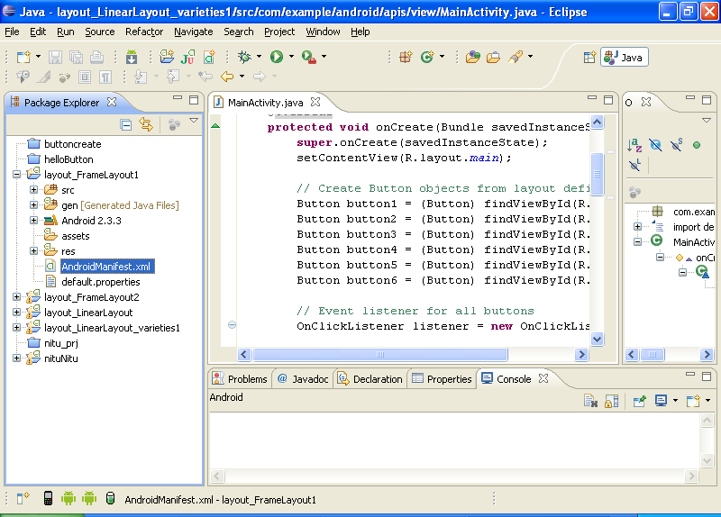

Slide 30
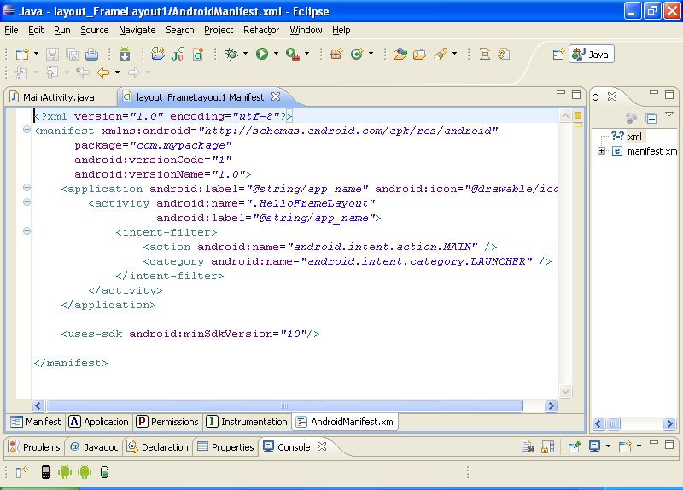

Slide 31
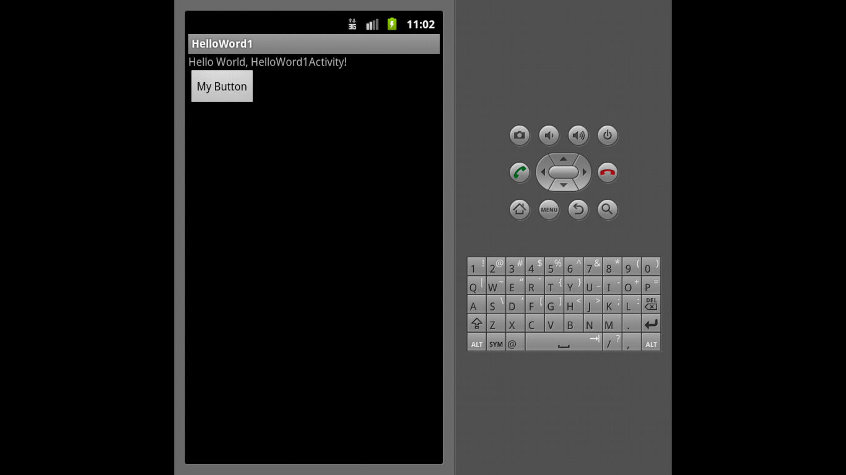

Slide 32
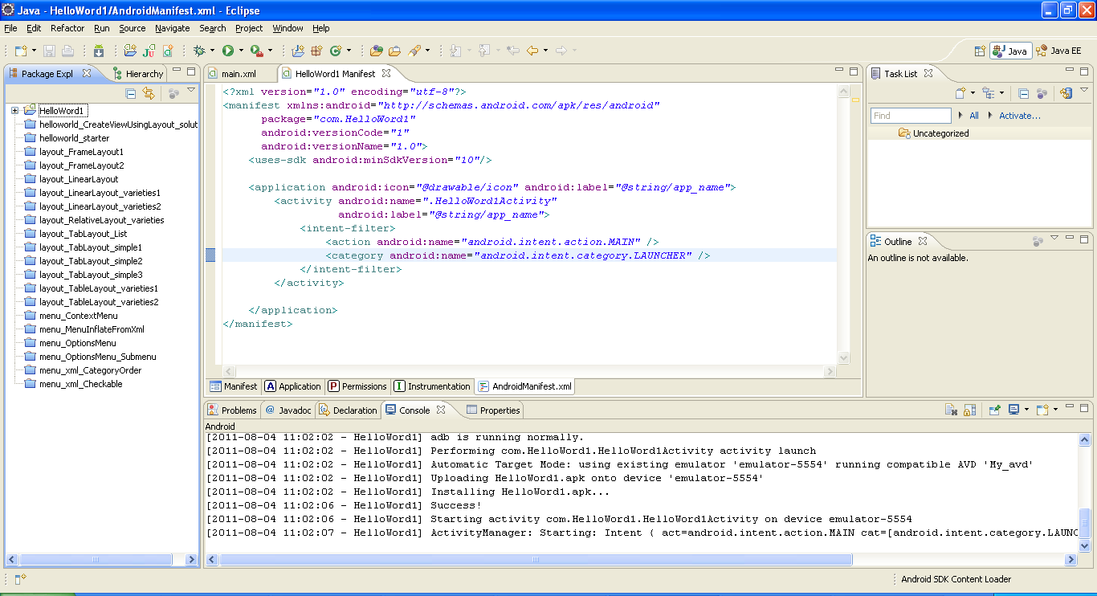

Slide 33
Intent Filters
An intent filter declares the capabilities of its parent component — what an activity or service can do and what types of broadcasts a receiver can handle
It opens the component to receiving intents of the advertised type, while filtering out those that are not meaningful for the component.
You can declare an intent filter for your
component by adding an <intent-filter> element as a child of
the component's declaration element.

Slide 34
Most of the contents of the filter are described by its <action>, <category>, and <data> subelements.
<intent-filter . . . >
<action android:name="com.example.project.SHOW_CURRENT" />
<action android:name="com.example.project.SHOW_RECENT" />
<action android:name="com.example.project.SHOW_PENDING" />
. . .
</intent-filter>

Slide 35
Example
for example,
The Note Pad sample application enables users to browse
through a list of notes, view details about individual items in
the list, edit the items, and add a new item to the list.
This section looks at the intent filters declared in its manifest file.

Slide 36
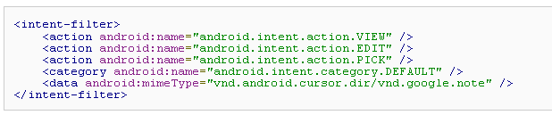
This filter declares the things that the activity can do on a directory of notes. It can allow the user to view or edit the directory (via the VIEW and EDIT actions), or to pick a particular note from the directory (via the PICK action).

Slide 37
Process and Threads
When an application component starts and the application does not have any other components running, the Android system starts a new Linux process for the application with a single thread of execution.
By default, all components of the same application run in the same process and thread
If an application component starts and there already exists a process for that application , then the component is started within that process and uses the same thread of execution.

Slide 38
Continue…
Android starts a Linux process for each application by default.
By default, all components of the application run in main thread of application’s process.
You can spawn separate threads for long operations.
Threads are created in code using standard Java Threadobjects

Slide 39
Continue…
The manifest entry for each type of component element <activity>, <service>, <receiver>, and <provider> supports an android:process attribute that can specify a process in which that component should run.
The Android system tries to maintain an application process for as long as possible.
Android kills the old processes based on importance when memory runs low.

Slide 40
Type of Process
Foreground process
Visible Process
Service Process
Background Process
Empty Process

Slide 41
Foreground process
- A process that is required for what the user is currently doing
- It hosts an Activity that the user is interacting with
(the Activity's onResume() method has been called).
- It hosts a Service that's bound to the activity that the user is interacting with.
- It hosts a Service that's running "in the foreground"
- It hosts a Service that's executing one of its lifecycle callbacks (onCreate(), onStart(), or onDestroy()).
- It hosts a BroadcastReceiver that's executing its onReceive() method.

Slide 42
Continue…
2) Visible process
- A process that doesn't have any foreground components, but still can affect what the user sees on screen.
- It hosts an Activity that is not in the foreground, but is still visible to the user (its onPause() method has been called)

Slide 43
Continue…
3)Service Process
A process that is running a service that has been started with the startService() method and does not fall into either of the two higher categories
Although service processes are not directly tied to anything the user sees, they are generally doing things that the user cares about (such as playing music in the background or downloading data on the network)

Slide 44
Continue…
4) Background process
A process holding an activity that's not currently visible to the user (the activity's onStop() method has been called).
These processes have no direct impact on the user experience

Slide 45
Continue…
5) Empty process
A process that doesn't hold any active application components

Slide 46
Continue…
There are five levels in the hierarchy according to importance,
Foreground process
Visible Process
Service Process
Background Process
Empty Process
Priority

Slide 47
Android Security Model
Each Android Application runs in its own process which is a secure sandbox.
Each Android package file installed on the device is given its own unique Linux user ID.
The permissions required by an application are declared statically in that application.
All Android applications must be signed.
Any data stored by an application will be assigned that application's user ID, and not normally accessible to other packages.

Slide 48
Android Security Model
Permissions required by application are declared in application manifest file.
<manifest xmlns:android="http://schemas.android.com/apk/res/android"package="com.android.app.myapp" ><uses-permission android:name="android.permission.RECEIVE_SMS" />
</manifest>
Permissions on components
Activity Permissions
Service Permissions
Broadcast Receiver Permissions
ContentProviderPermissions
URI Permissions

Slide 49
